Slide 1




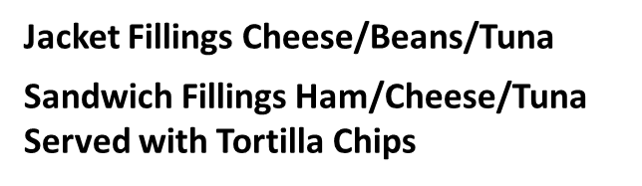
MENU CYCLE
WEEK ONE
Week commencing
13/4 27/4 11/5
1/6 15/6 29/6 13/6
Summer Term
MAIN COURSE | Tuna pasta bake | Minced beef puff pastry pie | Roast chicken with gravy | Beef Lasagne | Homemade Ham & Pineapple pizza
VEGETARIAN | Cheese & tomato parcel | Quorn sausage | Homemade cheese and onion Pie | Vegetable Lasagne | Homemade cheese & tomato pizza
EVERYDAY FAVOURITES | Chicken burger | Premium pork sausage | Handmade Sausage Roll | Chicken nuggets with tomato ketchup | Fish and chips
SIDES | Sauté potatoes Sweetcorn | Mashed potato Gravy Peas | Yorkshire pudding roast potatoes Carrots & broccoli | Herby diced potatoes sweetcorn | Chips Peas
AVAILABLE DAILY | Jacket potatoes Sandwiches Seasonal salad | Jacket potatoes Sandwiches Seasonal salad | Jacket potatoes Sandwiches Seasonal salad | Jacket potatoes Sandwiches Seasonal salad | Jacket potatoes Sandwiches Seasonal salad
DESSERTS | Mini Doughnuts fruit salad, Cheese & crackers | Iced bun, Jelly, Cheese & crackers | Ice Cream, Fruit salad, Cheese & crackers | Lemon Drizzle Cake , Jelly, Cheese & crackers | Vanilla shortbread, Fruit salad, Cheese & crackers

Slide 2
MENU CYCLE
WEEK TWO
Week commencing
20/4 4/5 18/5
8/6 22/6 6/7
Summer Term
MAIN COURSE | Fish fingers | Mild Chicken curry | Roast gammon with gravy | Bolognaise | Homemade peperoni pizza
VEGETARIAN | Veggie burger | Vegi crumble | Vegetarian cottage pie | Mac & cheese | Homemade cheese & tomato pizza
EVERYDAY FAVOURITES | Beefburger | Cheese & ham turn over | Meatballs in gravy | Hot dog with tomato ketchup | Salmon fishcake
SIDES | Oven baked wedges Garden peas | Rice Sweetcorn | Yorkshire pudding roast potatoes Carrots & broccoli | Pasta Garden peas | Chips Baked beans
AVAILABLE DAILY | Jacket potatoes Sandwiches Seasonal salad | Jacket potatoes Sandwiches Seasonal salad | Jacket potatoes Sandwiches Seasonal salad | Jacket potatoes Sandwiches Seasonal salad | Jacket potatoes Sandwiches Seasonal salad
DESSERTS | Chocolate Cake , Fruit salad, Cheese & crackers | Flapjack, Jelly, Cheese & crackers | Ice cream , Fruit salad, Cheese & crackers | Homemade Choc chip cookie , Jelly, Cheese & crackers | School sprinkle cake , Fruit salad, Cheese & crackers
Jacket Fillings Cheese/Beans/Tuna
Sandwich Fillings Ham/Cheese/Tuna
Served with Tortilla Chips

